Slide 1
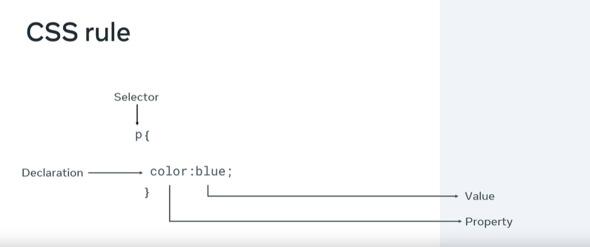
CSS rule
<link rel="stylesheet" href="style.css"/>

Slide 2
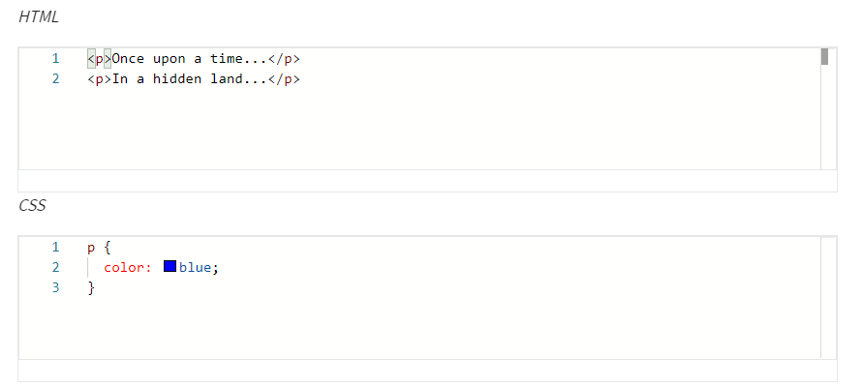
Selectors
Element Selectors

Slide 3
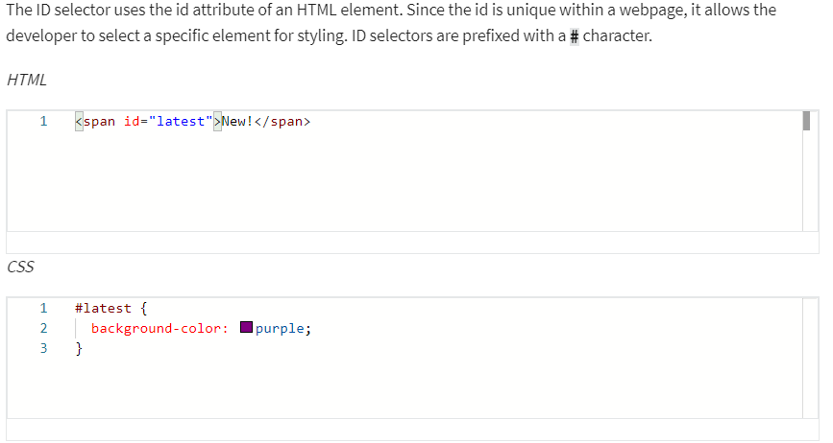
Selectors
ID Selectors

Slide 4
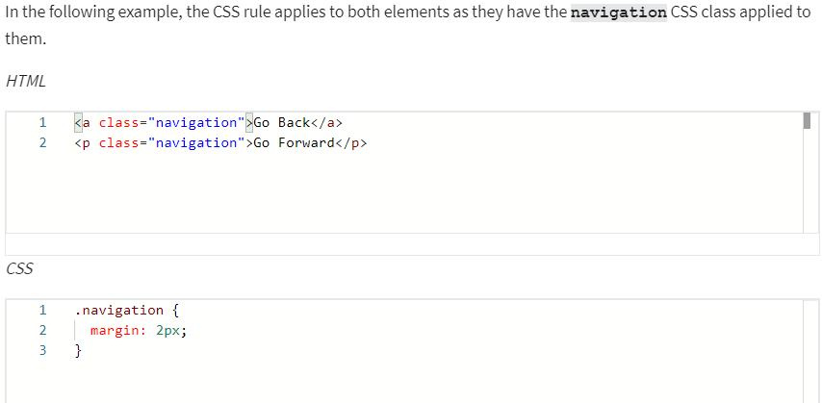
Selectors
Class Selectors

Slide 5
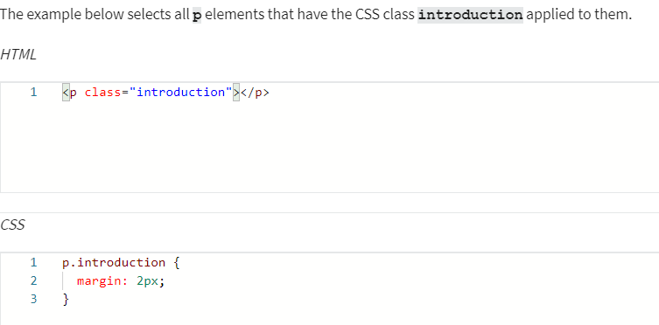
Selectors
Element with Class Selector

Slide 6
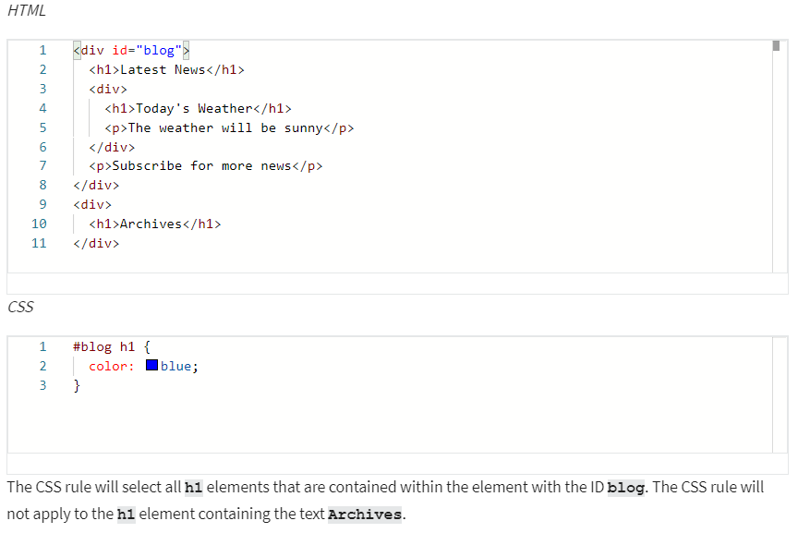
Selectors
Descendant Selectors

Slide 7
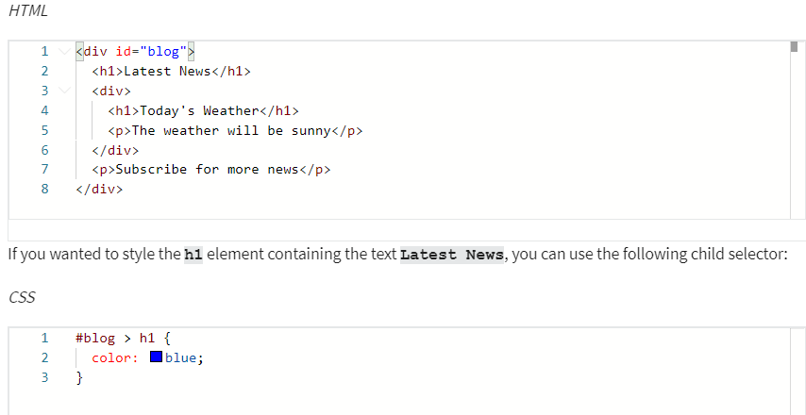
Selectors
Child Selectors
Note that this will not go beyond a single depth level. Therefore, the CSS rule will not be applied to the h1 element containing the text Today's Weather.

Slide 8
Text and color in CSS
color: rgb(255, 0, 0)
color: rgba(255, 0, 0, 0.8);
color: hsl(0, 100%, 50%)
Hex value
Predefined color names
font-family: "Courier New", monospace;
font-size: 12px;
text-transform: uppercase
text-decoration: underline red solid 5px
text-decoration-line: underline;
text-decoration-color: red;
text-decoration-style: solid;
text-decoration-thickness: 5px;
The most commonly used values for the text-transform property are: uppercase, lowercase, capitalize and none.
The most common text-decoration-line values used are: underline, overline, line-through and none.
There are many styles available for the text-decoration-style property; solid, double, dotted, dashed and wavy.

Slide 9
